Slide 1
CPP River Hawks
Event sign Up Instructions

Slide 2
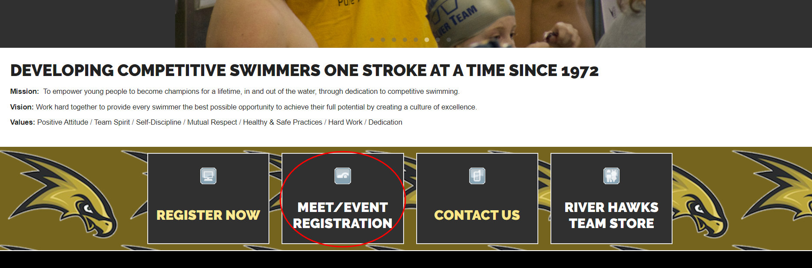
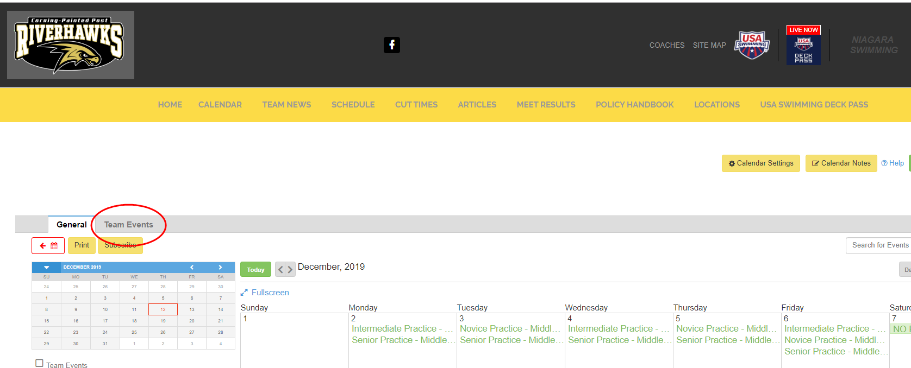
From the homepage: https://www.teamunify.com/team/nscyrr/page/home
Log into your account then click on Meet/Event Registration

Slide 3
You will need to click on the Team Events tab

Slide 4
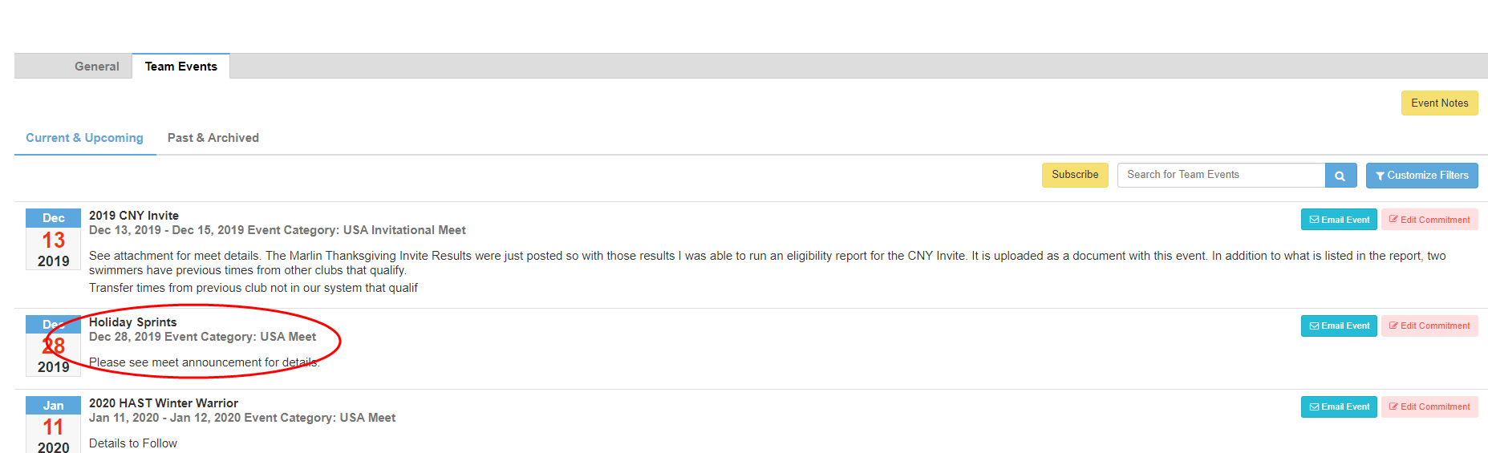
Click on the event name to get the details on the event

Slide 5
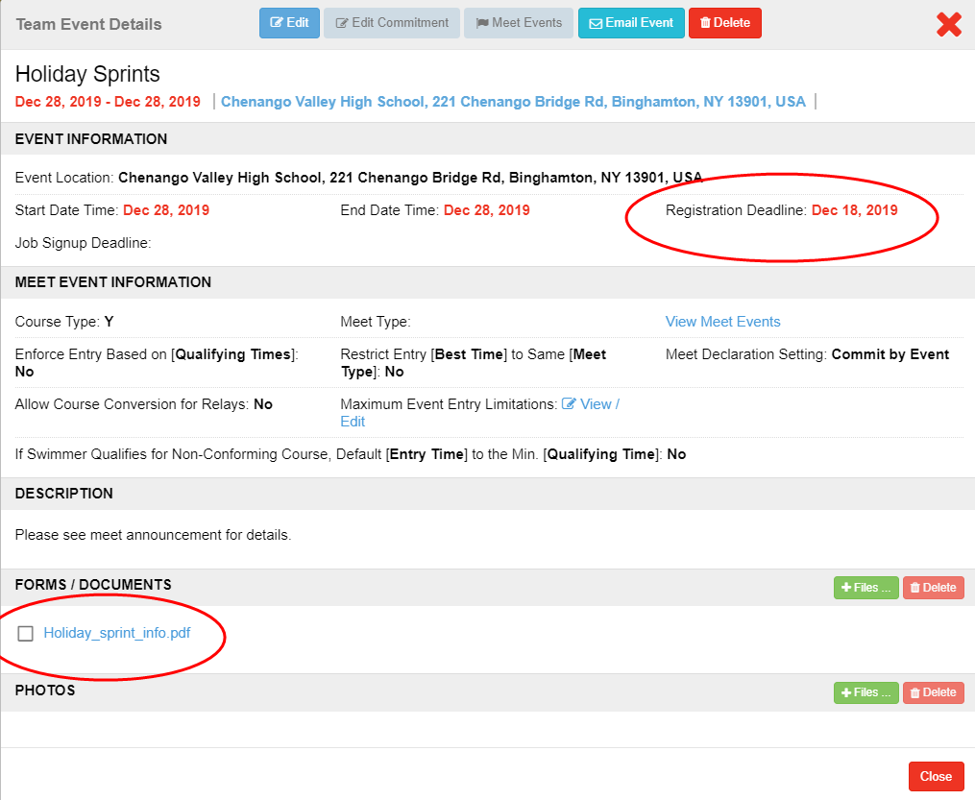
Two important pieces of information are found here:
Registration Deadline
Meet file with all the information you need on the event

Slide 6
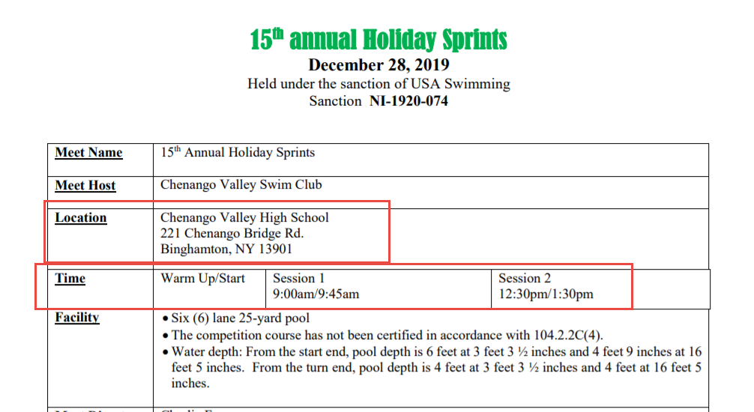
Always read the event .PDF, it gives you important need to know info on the meet:

Slide 7
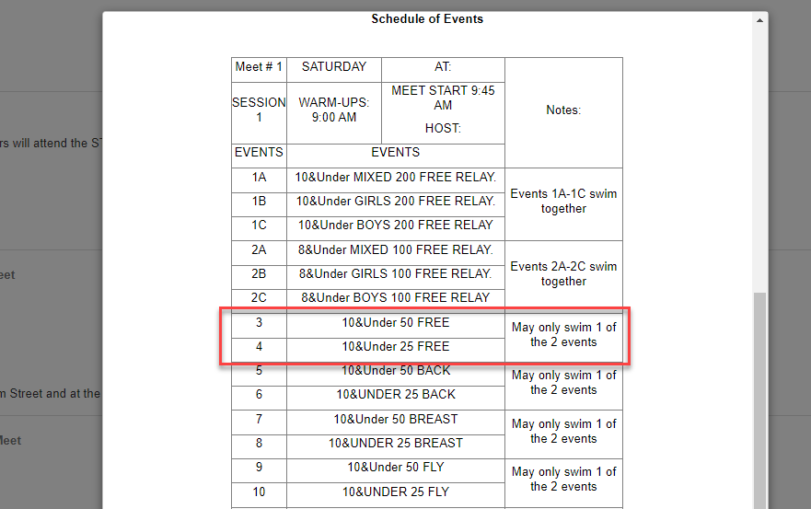
It also gives you instructions that we may not be able to code into the sign up:
For this meet, the sign up would allow you to pick both, but we are only allowed to swim one event of each stroke.

Slide 8
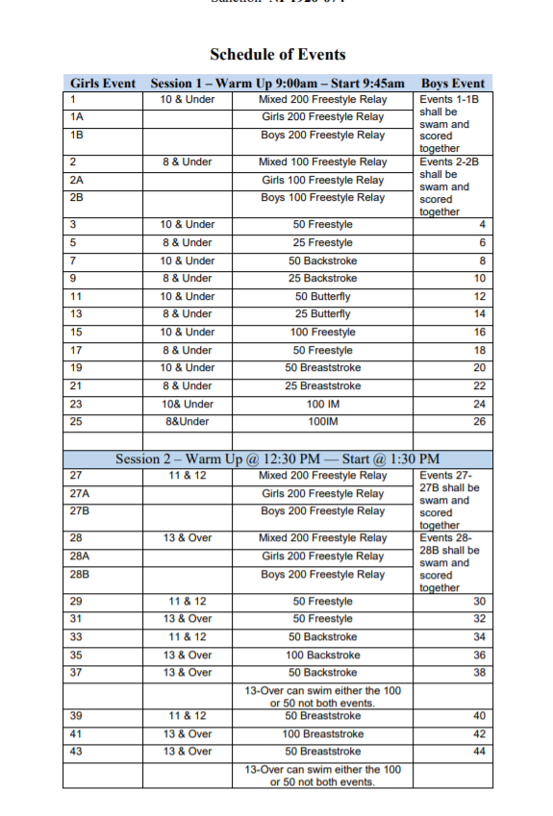
The PDF gives you important need to know info on the meet:
Event schedule will let you know what session your swimmer is in

Slide 9
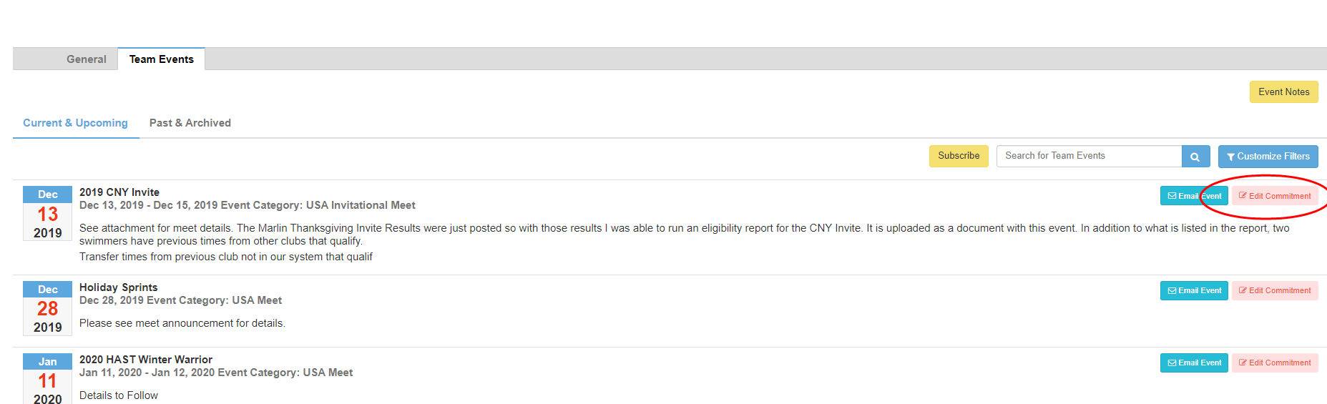
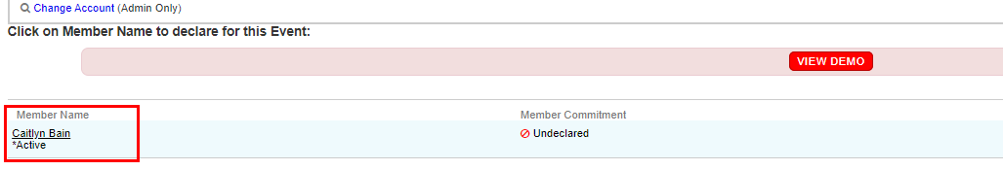
To commit or decline, click on “edit commitment”
Must be done before the registration deadline
Click on swimmers name to edit commitment

Slide 10
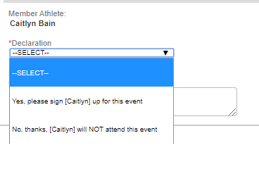
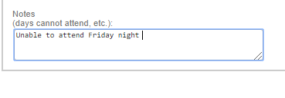
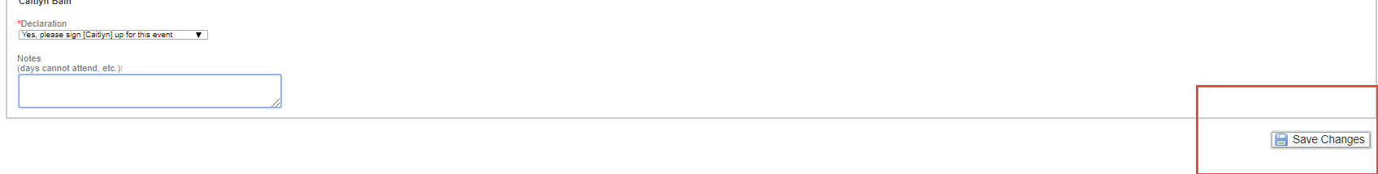
Choose Yes or No from drop down box and add any notes for the coach
Don’t forget to “save changes” for the commitment to be saved

Slide 11
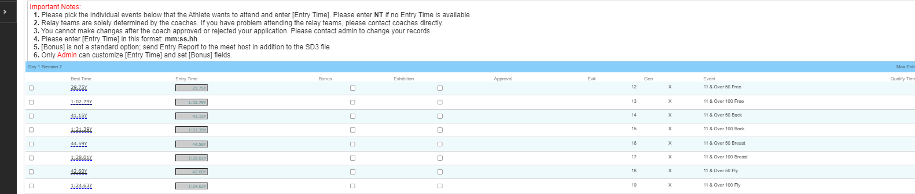
Choose Yes or No from drop down box and add any notes for the coach
Then choose events for your swimmer – remember to follow instructions from the event .pdf on number of entries per stroke

Slide 12
Finally, don’t forget to “save changes” for the commitment to be saved

Slide 13
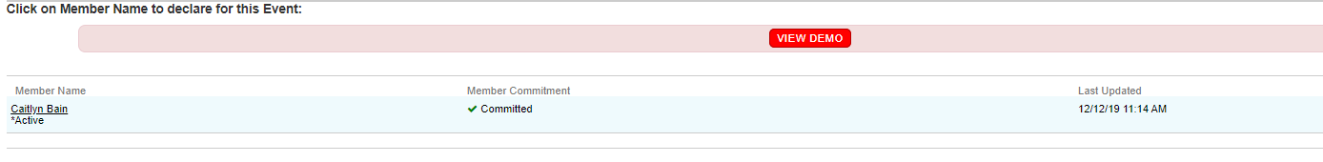
You know you’re done when it returns you to the athlete sign-up page and the member commitment matches your changes
Commitments and changes can be made up until the registration deadline

